Slide 1
Grace Church 101
Class 1: Our History, Mission, & Vision

Slide 2
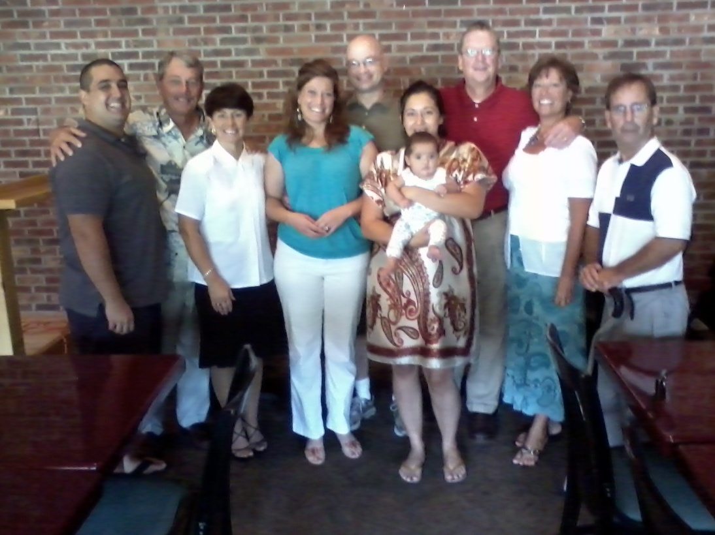
Short History of Grace Church

Slide 3
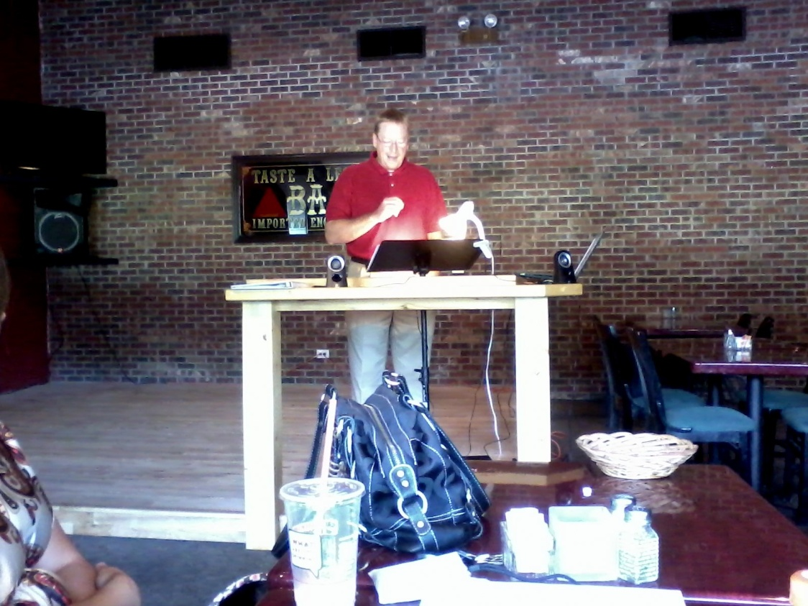
First Service

Slide 5
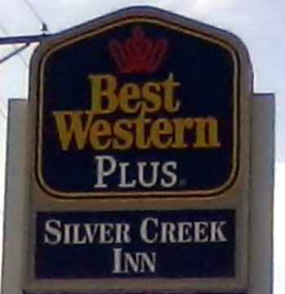
First Service

Slide 6
First Service

Slide 7
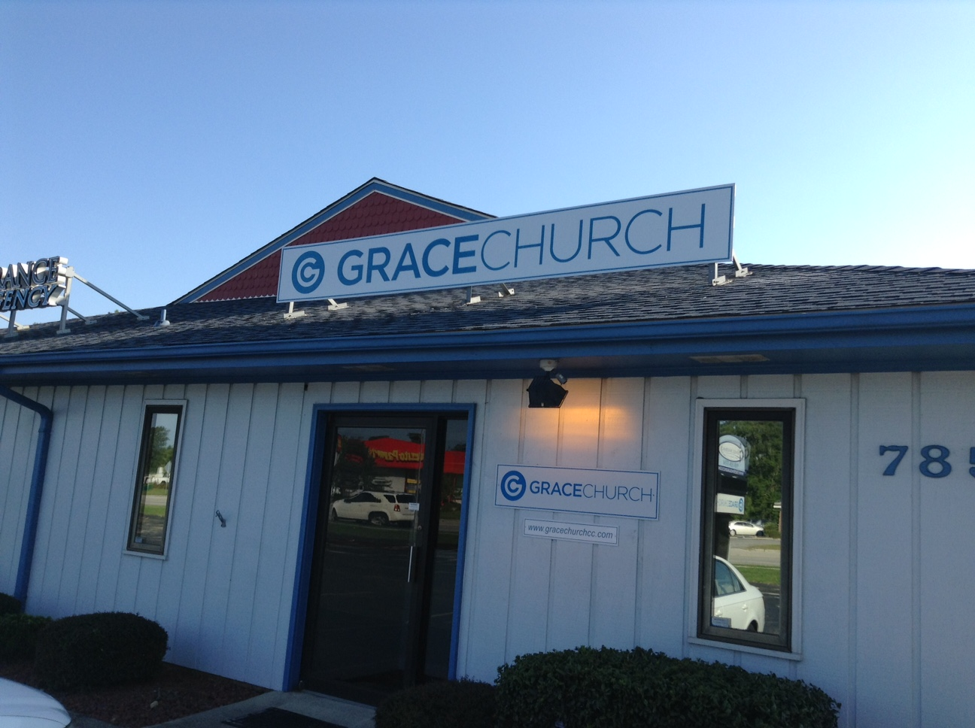
First Service

Slide 8
Our Mission
The mission of Grace Church is to make disciples of Jesus Christ in obedience to the Great Commission in Matthew 28:18-20:
“All authority in heaven and on earth has been given to me. Go therefore and make disciples of all nations, baptizing them in the name of the Father and of the Son and of the Holy Spirit, teaching them to observe all that I have commanded you. And behold, I am with you always, to the end of the age.”

Slide 9
Our Vision for Grace Church
A community with a robust theology that fuels joyful worship and a bold witness for Christ.
A community that reproduces itself in other church plants.
A community that growingly lives up to our theme verse:
“to live is Christ, and to die is gain. ~ Phil. 1:21

Slide 10
Acts 2:42-47
And they devoted themselves to the apostles' teaching and the fellowship, to the breaking of bread and the prayers. And awe came upon every soul, and many wonders and signs were being done through the apostles. And all who believed were together and had all things in common. And they were selling their possessions and belongings and distributing the proceeds to all, as any had need. And day by day, attending the temple together and breaking bread in their homes, they received their food with glad and generous hearts, praising God and having favor with all the people. And the Lord added to their number day by day those who were being saved.

Slide 11
Coming up next in Class 2:
The Gospel

