Slide 1
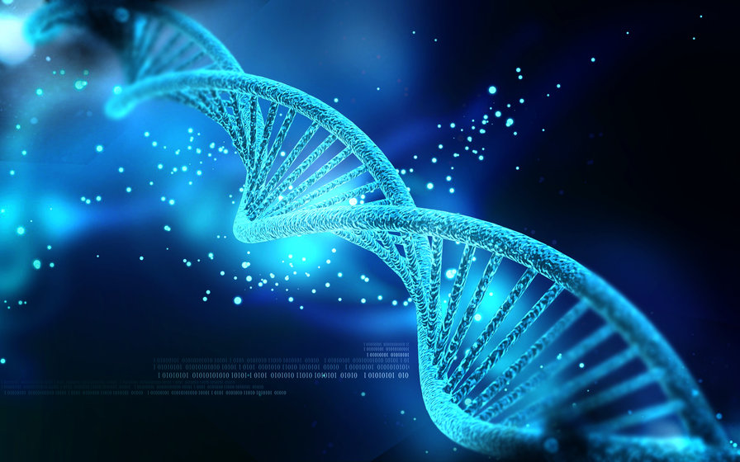
Grace Church 101
Class 3
The Theology of Grace Church

Slide 2
We are a
REFORMED, BAPTIST, CHURCH

Slide 3
1) Reformed?
The Reformed faith is the Christian religion that was recovered during the Protestant Reformation of the sixteenth and seventeenth centuries. Why Reformed? Because the church is always being reformed (being called back to the Word of God by the Spirit of God).

Slide 4
A faithful Reformed church is therefore a church that is constantly striving to think and act, to believe and live, according to the written Word of God. Churches who do not center themselves around the Word of God will find themselves on a path to destruction and the absence of God.

Slide 5
The Five Solas of the Reformation (sola = alone):

Slide 6
The 5 Points of Reformed Theology:

Slide 7
2) Baptist?
Free Will Baptist, Independent Baptist, PRimitive Baptist, Southern Baptist ... No
= Believers Baptist/Baptism ...
- Read page on website = “Baptism”

Slide 8
3) Church?
In its essence the church is the community of all true believers for all time.
- Both universal & local
- Visible (as we see) & invisible (as God sees)
- Body of Christ - everyone called out to Christ
I will build my church, and the gates of hell shall not prevail against it.
- Matthew 16:18

Slide 9
Marks of a true church:
1. Pure preaching of the Word
2. Right administration of the sacraments(Baptism / Lord's Supper).
3. Church Discipline
I will build my church, and the gates of hell shall not prevail against it.
- Matthew 16:18

Slide 10
A Few Other Highlights:
The Bible is the Word of God= Sufficient.
Eschatology - Freedom = non-essentials
Ecclesiology - Multiple elder led church

Slide 11
To be a member of Grace Church you don’t have to agree with everything presented in this class, you only need to be a Christian to join. But you do need to know that this is what we teach, believing it to be an accurate presentation of true Bible doctrine.
Homework:
Read “About Us” & “What We Teach” on website

