Slide 1
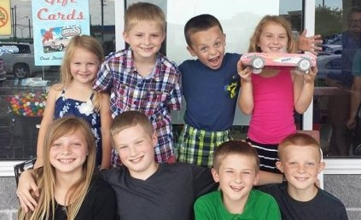
Grace Church 101
Class 5
Children in Worship

Slide 2
Families worshiping together: We do provide childcare for the very young, up to about age 4. We also may offer something other ages in the furture. But, we love to see entire families together engaged in joyful worship!

Slide 3
On the website - the bottom of the “Who We Are” page - you will find an article by John Piper:
The Family: Together in God’s Presence.
A few points from the article:

Slide 4
“The greatest stumbling block for children in worship is that their parents do not cherish the hour. Children can feel the difference between duty and delight. Therefore, the first and most important job of a parent is to fall in love with the worship of God.”
- Children need to see their parents worshiping God!

Slide 5
“To sit still and be quiet [during worship] is not an excessive expectation for a healthy 6-year-old who has been taught to obey his parents. It requires a measure of discipline, but that is precisely what we want to encourage parents to impart to their children in the first five years.”
- Teach you children to be God-centered. Their greatest need is not to be entertained.

Slide 6
“Children absorb a tremendous amount that is of value. And this is true even if they say they are bored. Music and words become familiar. The message of the music starts to sink in. The form of the service comes to feel natural. ... Even if most of the sermon goes over their heads, experience shows that children hear and remember remarkable things.”
- God's Spirit is at work through the Word!

Slide 7
“There is a sense of solemnity and awe which children should experience in the presence of God. This is not likely to happen in children’s church. Is there such a thing as children’s thunder or children’s lightning or the crashing of the sea “for children”?”
We do not believe that children who have been in children’s church for several years between the ages of six and twelve will be more inclined or better trained to enjoy worship than if they had spent those years at the side of their parents. In fact, the opposite is probably the case.”

Slide 8
“It will probably be harder to acclimate a 10- or 12-year-old to a new worship service than a 5- or 6-year-old. The cement is much less wet, and vast possibilities of shaping the impulses of the heart are gone.”

Slide 9
“We discovered that the very earliest 'school' for worship is in the home — when we help a baby be quiet for just a moment while we ask God’s blessing on our meal; when a toddler is sitting still to listen to a Bible story book; when a child is learning to pay attention to God’s word and to pray during family devotional times..”

Slide 10
“The setting of the tight family circle focusing toward God will be a nonverbal picture growing richer and richer in the child’s mind and heart as he matures in appreciation for his family and in awe at the greatness of God.”

Slide 11
“Psalm 78:3-4
What we have heard and known, what our fathers have told us. We will not hide them from their children; we will tell the next generation the praiseworthy deeds of the Lord, his power, and the wonders he has done..”
Next: Biblical Church Membership

